Slide 1
x1281z - ISO E-test Scalar calculations suggestion
Gilad Z

Slide 2

Methodology
For ISO structures
PGD LKG: Fail mode # calculation : Number of LKG paths in Unit cell x # of Unit cell in structure
OGD LKG: Fail mode # calculation : Number of LKG paths (or # of active PLY) x Overlap length x # of Unit cell in structure
For Diff CHN
# of fail mode = Number of transistors in CHN
Scalar calculation = $\frac{1}{fail mode \#}$
*OGD Overlap length = # of overlap Diff tracks

Slide 3
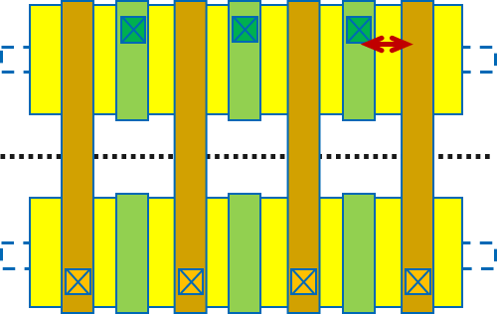
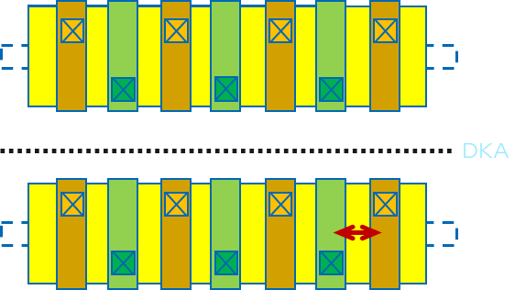
CTG OGD SDR device
CRL
DKA
CRL
6 LKG paths
Overlap 1 Diff TRK long
For this small example
Fail mode # = 6x1=6
Scalar = 1/6
12 LKG paths
Overlap 1 Diff TRK long
For this small example
Fail mode # = 12x1=12
Scalar = 1/12
6 LKG paths
Overlap 2 Diff TRK long
For this small example
Fail mode # = 6x2=12
Scalar = 1/12
Two of the structures are very different, but has similar scalar
In a Unit cell usually, there will be more LKG paths
‘valid’ LKG path

Slide 4
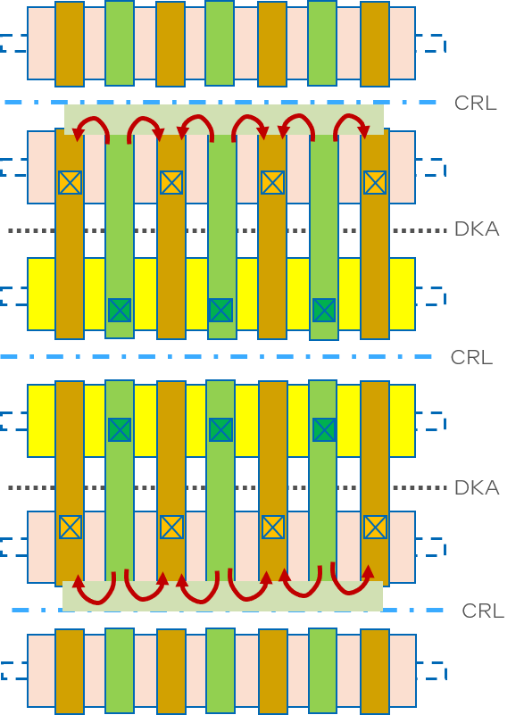
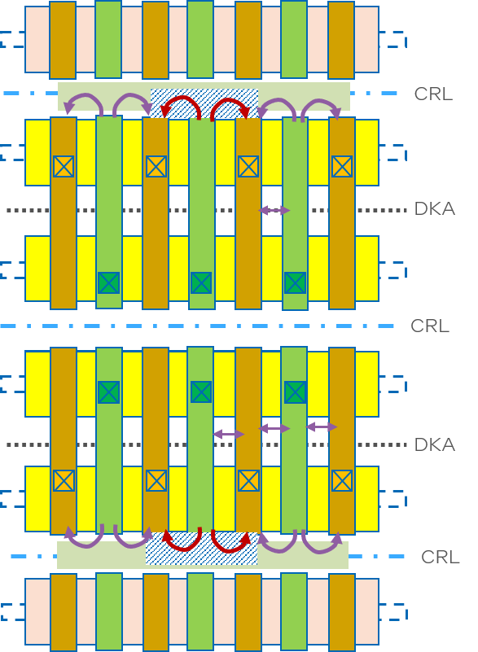
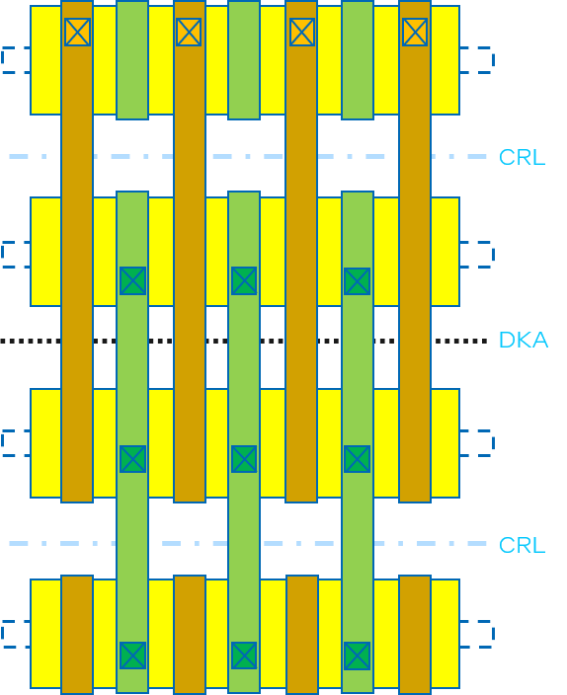
CTG OGD
LKG through VCR (PGD skew)
LKG through VCRNUB (OGD skew)
Add VG to SDR
6 LKG paths
Overlap 2 Diff TRK long
For this small example
Fail mode # = 6x2=12
Scalar = 1/12
12 LKG paths?
OGD Overlap not valid?
For this small example
Fail mode # = 12 ?
Scalar = 1/12
4 LKG paths?
OGD Overlap not valid?
For this small example
Fail mode # = 4 ?
Scalar = 1/12
Regardless the fail-mode tested KEEP SCALAR AS IF WE WERE LOOKING AT SDR STRUCTURE
tested LKG path
Other effective LKG path

Slide 5
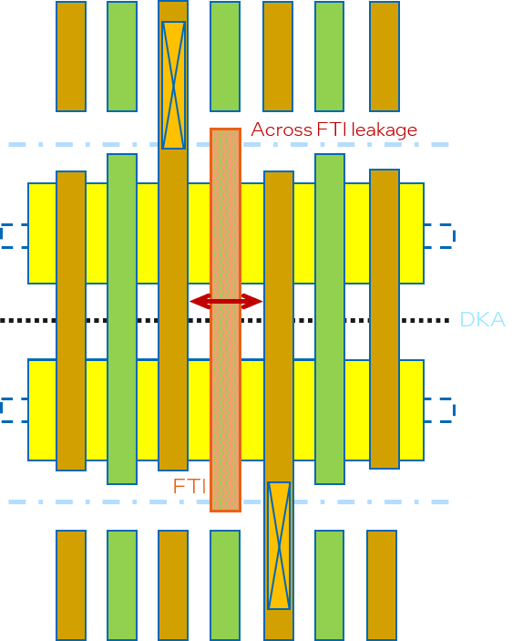
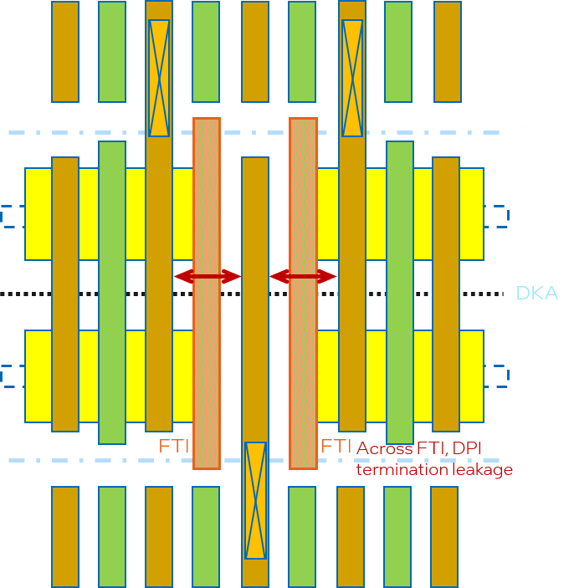
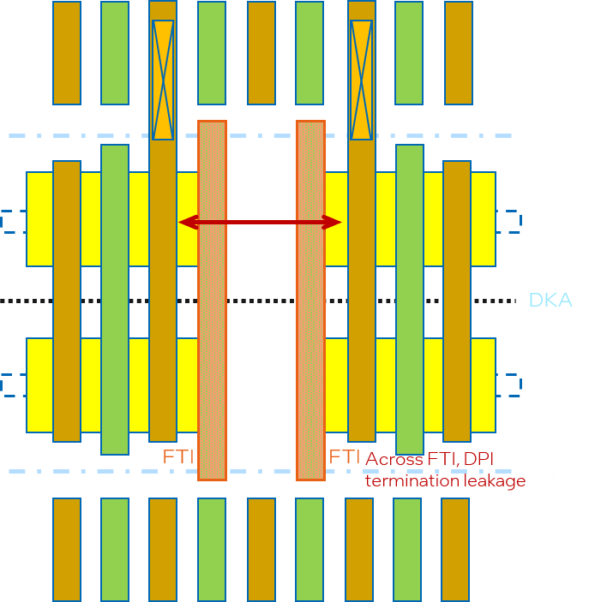
CTG OGD
LKG through diff depop
Diffusion ISO type a
type b1
type b2
1 LKG paths (no active PLY)
OGD Overlap 2 Diff tracks
For this small example
Fail mode # = 2
Scalar = 1/2
2 LKG paths (no Active PLY)
OGD Overlap 2 Diff tracks
For this small example
Fail mode # = 4
Scalar = 1/4
1 LKG paths (no active PLY)
OGD Overlap 2 Diff tracks
For this small example
Fail mode # = 2
Scalar = 1/2
Occasionally , # of active PLY doesn’t work
tested LKG path
Other effective LKG path

Slide 6
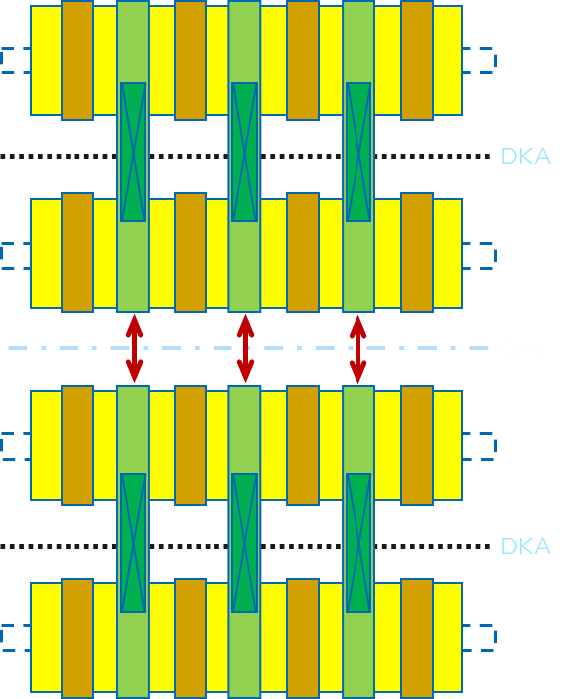
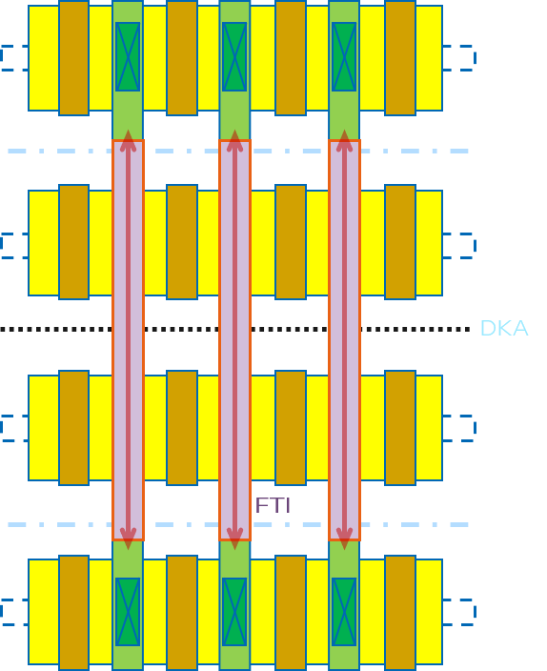
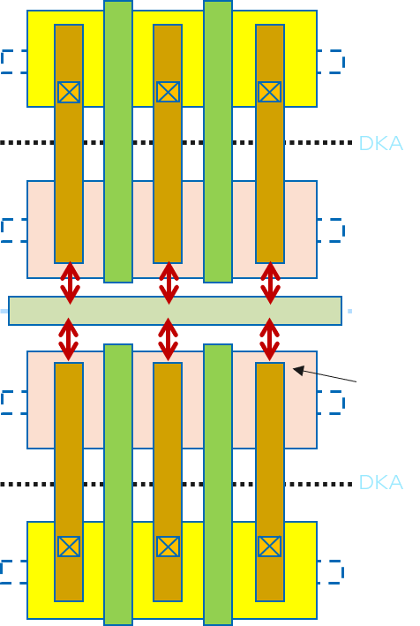
ETE PGD
Gate ETE
Gate ETE through FTI
TCN to VCR
3 LKG paths
For this small example
Fail mode # = 3
Scalar = 1/3
3 LKG paths
For this small example
Fail mode # = 3
Scalar = 1/3
6 LKG paths
For this small example
Fail mode # = 6
Scalar = 1/6
tested LKG path
Other effective LKG path

Slide 7
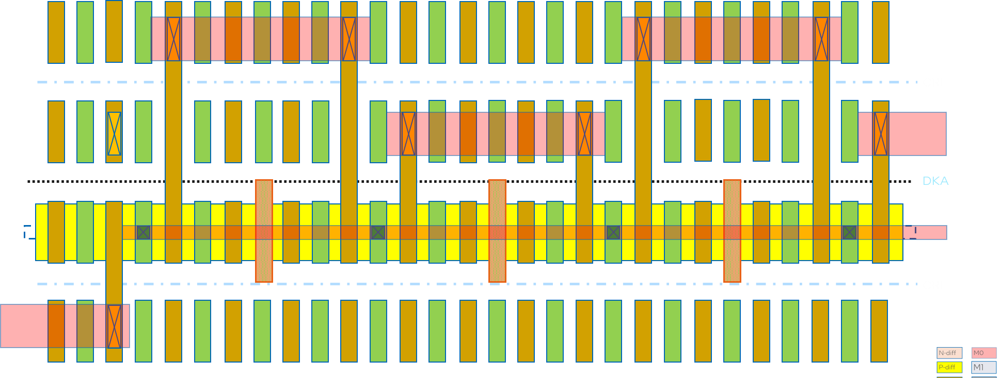
Diffusion Chain
1
2
3
4
4 transistors in path
For this small example
Fail mode # = 4x
Scalar = 1/4
FTI -
tested Current path

Slide 8
Compare E-Test parameter content Different X80 TC
ISO
TC | Test row | StructureName | StructureComments | arrayX | arrayY | Test Type | Scalar | Force
X80C | x80cs_be_iso2 | VT_MV_Z1N/M0C_14/34_14/13_14X14_VTGATE_0_108H | VTGATEOGD-108NL32-DKAM0C-SDR | 6 | 40 | I2,I2,I2,I2 | 1,1,1,1 | 0.7V,1.1V,-0.7V,-1.1V
X80C | x80cs_be_iso2 | VT_MV_Z3N/M0C_14/34_16/13_14X16_VTM0_0_144H | VTM0BPGD-144NL50-DKASALELE-SDR | 6 | 40 | I2,I2,I2,I2 | 1,1,1,1 | 0.7V,1.1V,-0.7V,-1.1V
X80C | x80cs_be_iso2 | VG_MV_Z3P/M0B_14/34_16/13_14X16_VGTCN_0_144H | VGTCNOGD-144PL50-DKAM0B-SDR | 6 | 40 | I2,I2,I2,I2,VBE | 1,1,1,1,1 | 0.7V,1.1V,-0.7V,-1.1V,NA
X80C | x80cs_fe_iso_2 | GATEPGD-126PL43-ISO1PP-SDR | 126h EMR 43W LVT P-diff Gate ETE MGC ISO 1PP at DKA LNRP | 5 | 60 | I2,I2,I2,I2 | 0.0033333,0.0033333,0.0033333,0.0033333 | 0.65V,1.1V,-0.65V,-1.1V
X80C | x80cs_fe_iso_2 | GATEPGD-126NL43-ISO2PP-SDR | 126h EMR 43W LVT N-diff Gate ETE MGC ISO 2PP at DKA LNRP | 5 | 60 | I2,I2,I2,I2 | 0.0016667,0.0016667,0.0016667,0.0016667 | 0.65V,1.1V,-0.65V,-1.1V
X80C | x80cs_fe_iso_2 | GATEPGD-108NL34-MGCDKA-SDR | 108h EMR 34W LVT N-diff Gate ETE MGC ISO PCT Long at DKA LNRP | 5 | 60 | I2,I2,I2,I2 | 0.0002778,0.0002778,0.0002778,0.0002778 | 0.65V,1.1V,-0.65V,-1.1V
X80Z | x80zs_diff_iso_2a | DIFFOGD-P45E108-Z2LN-SDR | 108h EMR 38W LVT N-diff SDR [c] type | 7 | 130 | I2,I2,I2,I2 | 1,1,1,1 | 0.65V,1.1V,-0.65V,-1.1V
X80Z | x80zs_diff_iso_2a | DIFFOGD-P45E108-Z2LN-SDR-FTI | 108h EMR 38W LVT N-diff SDR [c] type with FTI | 7 | 130 | I2,I2,I2,I2 | 1,1,1,1 | 0.65V,1.1V,-0.65V,-1.1V
X80Z | x80zs_diff_iso_2a | DIFFOGD-P45E108-Z2LNP-FTILL | 108h EMR 38W LVT NP-diff FTI long length - full DUT | 6 | 150 | I2,I2,I2,I2 | 1,1,1,1 | 0.65V,1.1V,-0.65V,-1.1V
X80Z | x80zs_epi2epi_1 | EPIEPIPGD-P45D126-Z2LN-SDR | 126h RDVB 39W LVT N-diff SDR Epi-Epi shorts | 6 | 130 | I2,I2,I2,I2 | 1,1,1,1 | 0.65V,1.1V,-0.65V,-1.1V
X80Z | x80zs_epi2epi_1 | EPIEPIPGD-P45E126-Z3LN-JOG-Z3Z2 | 126h EMR 47W LVT N-diff Jog Z3 to Z2 | 6 | 130 | I2,I2,I2,I2 | 1,1,1,1 | 0.65V,1.1V,-0.65V,-1.1V
X80Z | x80zs_epi2epi_1 | EPIEPIPGD-P45E108-Z0LP-SDR | 108h EMR 26W LVT P-diff SDR Epi-Epi shorts | 6 | 150 | I2,I2,I2,I2 | 1,1,1,1 | 0.65V,1.1V,-0.65V,-1.1V
X80A | x80as_gate_ete1_iso | GATEPGD-144NPL38-FTISL-SDR | 144h EMR 38W LVT NP-diff Gate ETE SDR iso thru FTI [b] type | 5 | 50 | I2,I2,I2,I2 | 1,1,1,1 | 0.65V,1.1V,-0.65V,-1.1V
X80A | x80as_gate_ete1_iso | GATEPGD-108PH38-FTISL-SDR | 108h EMR 38W HVT P-diff Gate ETE SDR iso thru FTI [b] type | 5 | 65 | I2,I2,I2,I2 | 1,1,1,1 | 0.65V,1.1V,-0.65V,-1.1V
X80A | x80as_gate_ete1_iso | GATEPGD-144NPL38-MGCDKA-SDR | 144h EMR 38W LVT NP-diff Gate ETE SDR at DKA [a] type | 6 | 50 | I2,I2,I2,I2 | 1,1,1,1 | 0.65V,1.1V,-0.65V,-1.1V
X80A | x80as_fe102_gete05_iso | CTGOGD-102NL35-CTCN-SDR | 102h EMR 35W LVT N-diff TCN-to-Gate SDR | 6 | 65 | I2,I2,I2,I2 | 1,1,1,1 | 0.65V,1.1V,-0.65V,-1.1V
X80A | x80as_fe102_gete05_iso | GTGOGD-102PL26-1D-SDR | 102h EMR 26W LVT P-diff Gate-to-Gate SDR1dummy | 6 | 65 | I2,I2,I2,I2 | 1,1,1,1 | 0.65V,1.1V,-0.65V,-1.1V
X80A | x80as_fe102_gete05_iso | CTGOGD-102PL26-CTCN-SDR | 102h EMR 26W LVT P-diff TCN-to-Gate SDR | 6 | 65 | I2,I2,I2,I2 | 1,1,1,1 | 0.65V,1.1V,-0.65V,-1.1V
CHN
TC | Test row | StructureName | StructureComments | arrayX | arrayY | Test Type | Scalar | Force
X80Z | x80zs_diff_iso_3a | DIFFCHNOGD-126EZ1LN-M0CHNLEN10 | Diff CHN with M0 LEN-10T 126h EMR 30W LVT N-diff | 1 | 1 | R2,R2,R2,R2 | 1,1,1,1 | 0.65V,1.1V,-0.65V,-1.1V
X80Z | x80zs_diff_iso_3a | DIFFCHNOGD-126EZ1LP-LEN10 | Diff CHN LEN-10T 126h EMR 30W LVT P-diff | 1 | 1 | R2,R2,R2,R2 | 1,1,1,1 | 0.65V,1.1V,-0.65V,-1.1V
X80Z | x80zs_diff_iso_3a | DIFFCHNOGD-108EZ2LN-LEN10 | Diff CHN LEN-10T 108h EMR 38W LVT N-diff | 1 | 1 | R2,R2,R2,R2 | 1,1,1,1 | 0.65V,1.1V,-0.65V,-1.1V
X80C | x80cs_fe_iso_1 | DIFFCHNOGD-144PL50-LEN18-SDR | 144h 50W with noldfm ID LVT P-diff Diff CHN LEN-18T | 1 | 1 | I2,I2,I2,I2 | 0.055556,0.055556,0.055556,0.055556 | 0.65V,1.1V,-0.65V,-1.1V
X80C | x80cs_fe_iso_1 | DIFFCHNOGD-126PL41-LEN18-SDR | 126h 41W with noldfm ID LVT P-diff Diff CHN LEN-18T | 1 | 1 | I2,I2,I2,I2 | 0.055556,0.055556,0.055556,0.055556 | 0.65V,1.1V,-0.65V,-1.1V
X80C | x80cs_fe_iso_1 | DIFFCHNOGD-108PL32-LEN18-SDR | 108h 32W with noldfm ID LVT P-diff Diff CHN LEN-18T | 1 | 1 | I2,I2,I2,I2 | 0.055556,0.055556,0.055556,0.055556 | 0.65V,1.1V,-0.65V,-1.1V
X80A | x80as_diff_iso2 | DIFFCHNOGD-126NL38-M0LEN10-SDR | 126h 38W LVT N-diff Diff CHN with M0 LEN-10T | 1 | 1 | R2,R2 | 1,1 | 0.65V,1.1V
X80A | x80as_diff_iso2 | DIFFCHNOGD-126NL38-LEN20-SDR | 144h 38W LVT N-diff Diff CHN LEN-20T | 1 | 1 | R2,R2 | 1,1 | 0.65V,1.1V
X80A | x80as_diff_iso2 | DIFFCHNOGD-144NL56-LEN20-SDR | 144h 56W with noldfm ID LVT N-diff Diff CHN LEN-20T | 1 | 1 | R2,R2 | 1,1 | 0.65V,1.1V

